Slide 1
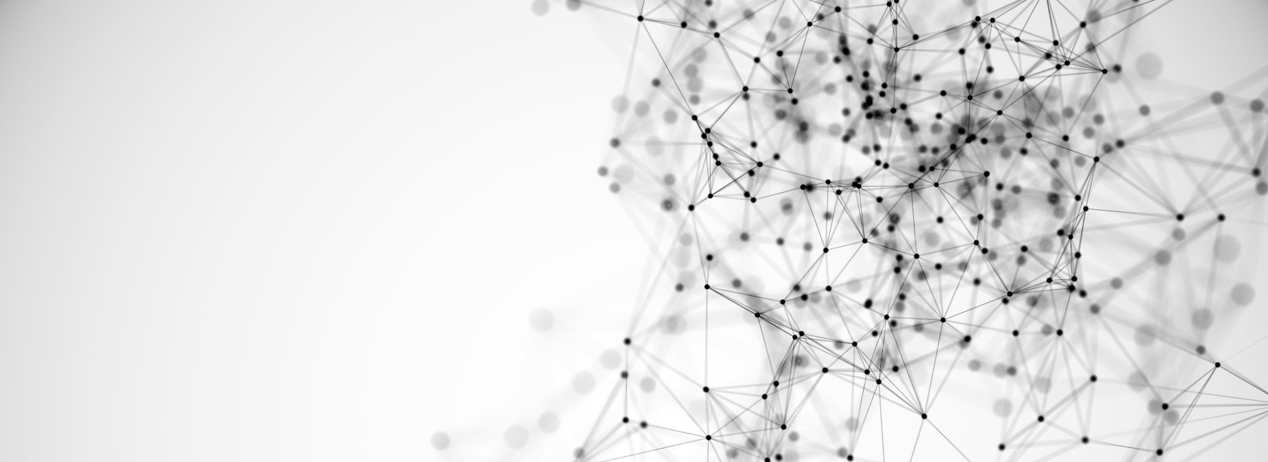
Leaky Integrate and Fire Neuron.
Concept Breakdown:
The Biological Background of the Leaky Integrate and Fire Neuron.
The Mathematical and Modeling conversion of the LIF Neuron.
Application of the LIF for solving Real Life Problems.

